Slide 1
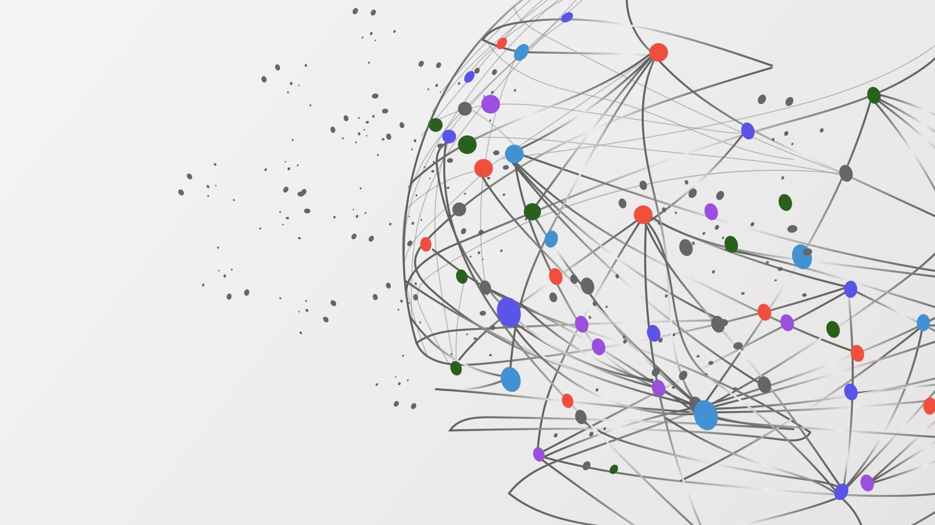
Final Project
CS 760 – Machine Learning
Ayushi Mishra, Neil Bhutada

Slide 2
Goals & Ideas
Goals
Predicted Biological Age & Death.
Used Weighted – KNN and GBM to predict outputs. PCA for outliers, and UMAP for visualization.
Biological Age Prediction
Compared CT and clinical data of patients who were alive and healthy with people who died.
Filtered data to select alive patients with healthy CT and clinical data
Created model using data of these patients as training set
Predicted Biological age of patients who died and had similar CT and clinical data

Slide 3
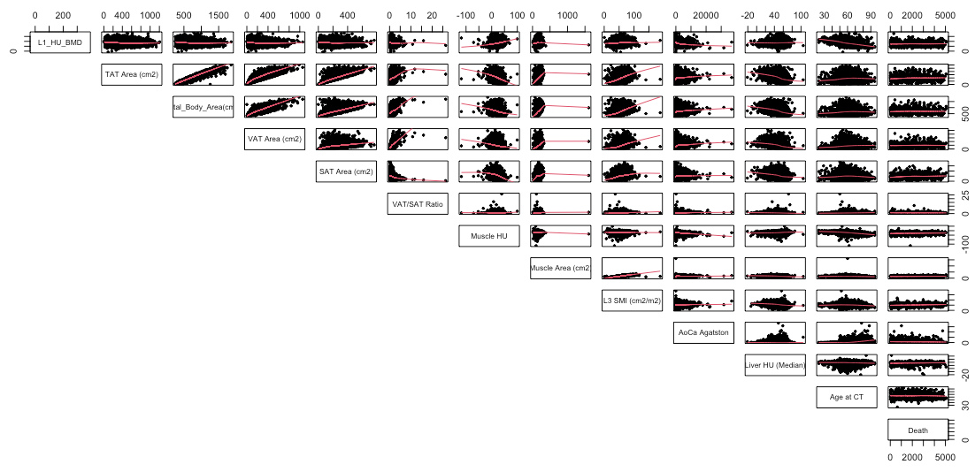

Slide 4
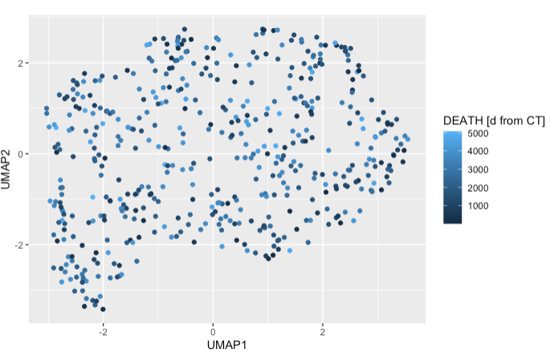

Slide 5
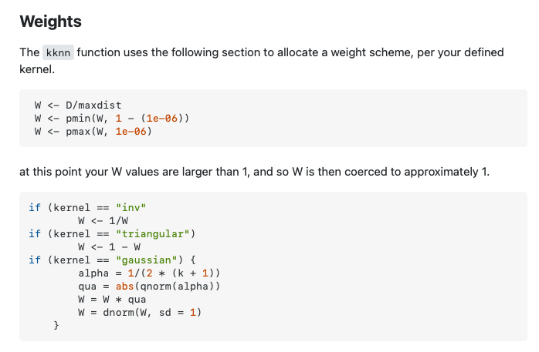
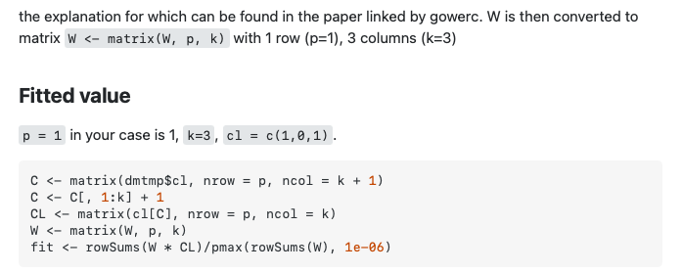
Weighted K-NN Pseudo Code
References: https://stackoverflow.com/questions/65654487/weighted-k-nearest-neighbors-and-r-kknn-package

Slide 6
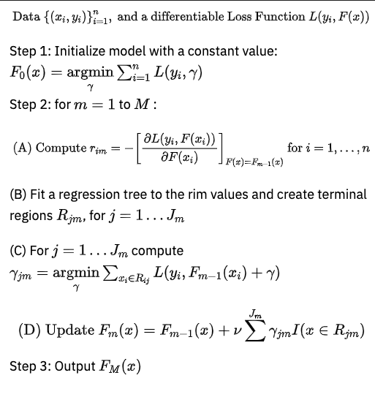
GBM Algorithm
Hastie, Trevor, Robert Tibshirani, and J Jerome H Friedman. The Elements of Statistical Learning. Vol.1. N.p., page 339: Springer New York, 2001.

Slide 7
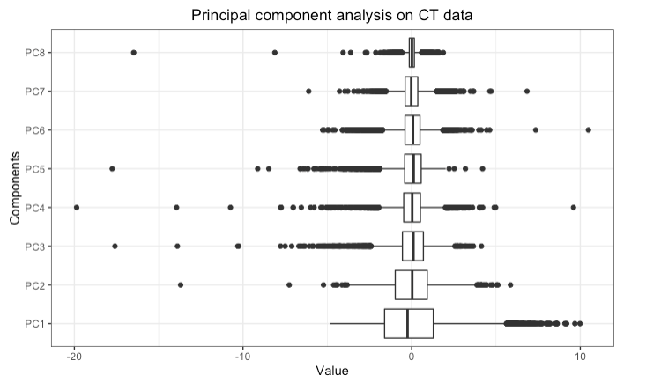
Pre-processing steps
Performed Principal Component Analysis to remove outliers.

Slide 8
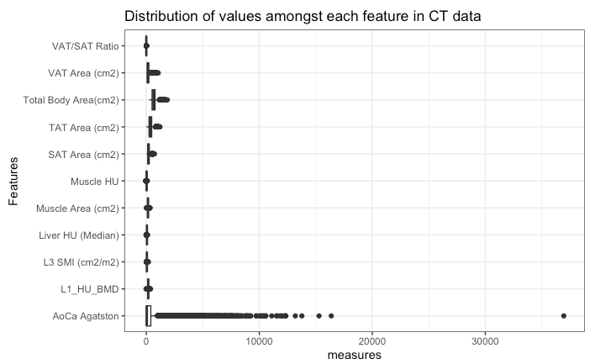
Pre-processing steps
Filtered out unhealthy data points from CT data
Captured data points within upper and lower hinge – L1 HU BMD, AoCA Agatston
Upper hinge: Q3 + 1.5 * IQR
Lower Hinge: Q1 – 1.5 * IQR

Slide 9
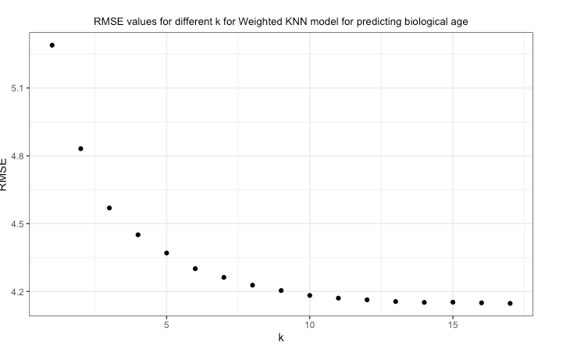
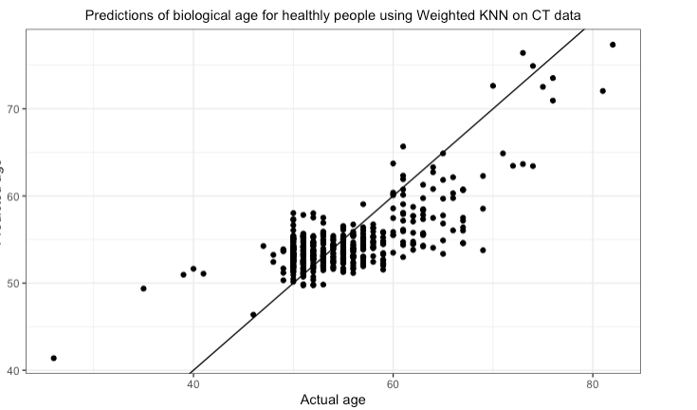
Predicting biological age using Weighted KNN using CT data

Slide 10
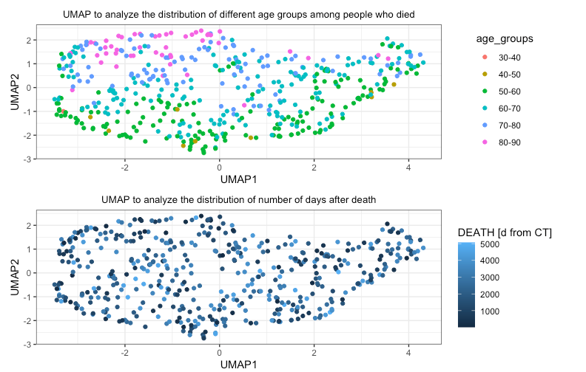
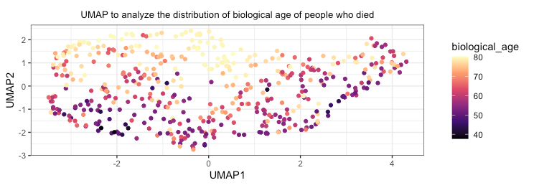
UMAP Visualization of Weighted K-NN

Slide 11
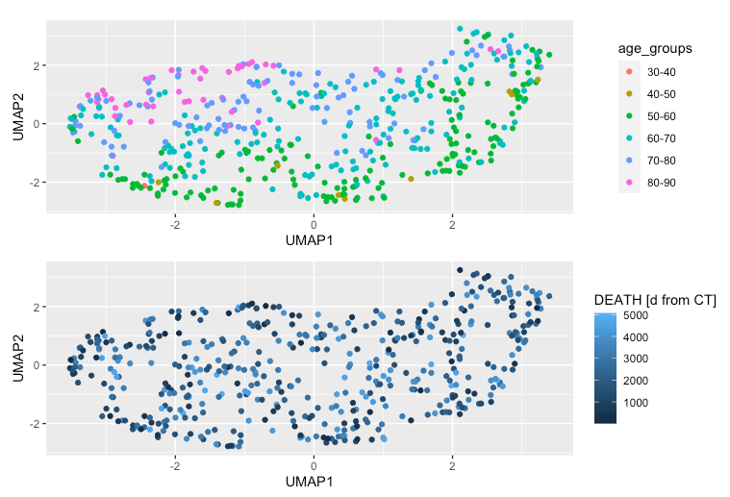
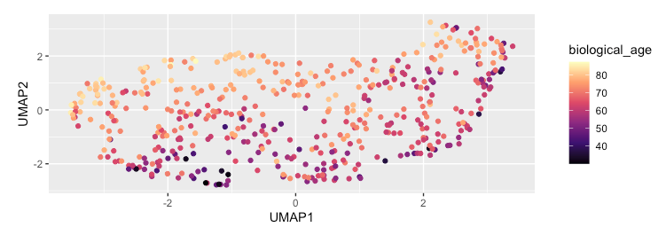
Predicting biological age of healthy people using GBM using CT data

Slide 12
Pre-processing steps
Filtered out unhealthy people from clinical data
Considered people with BMI < 30
No tobacco consumption
Framingham Risk score less than 0.19
Had no metabolic syndrome
Captured data within upper and lower hinge - FRAX 10y Fx Prob (Orange-w/ DXA), FRAX 10y Hip Fx Prob (Orange-w/ DXA)

Slide 13
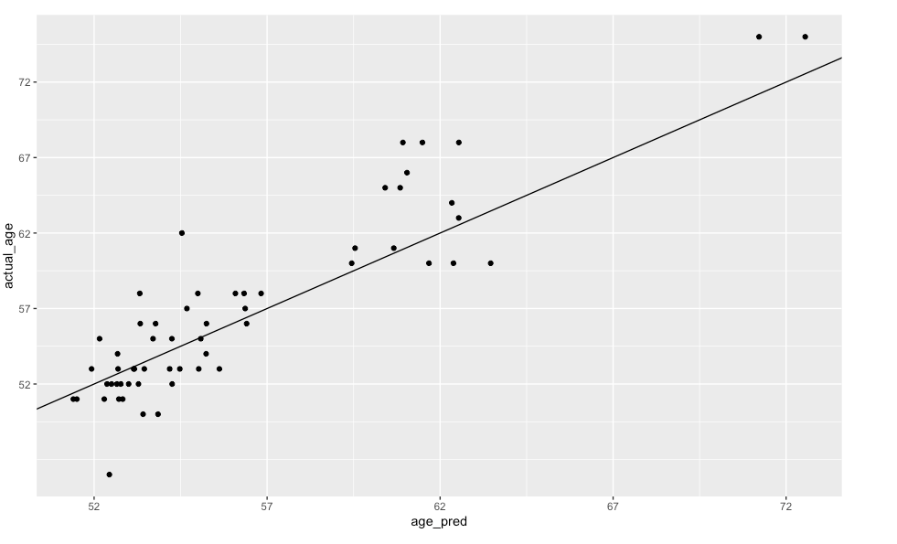
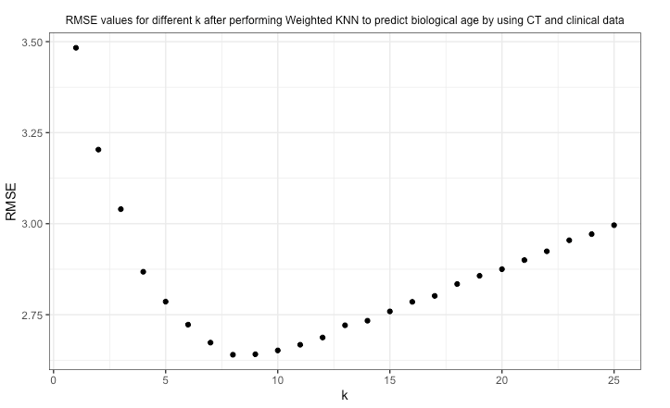
Predicting Biological Age of healthy people with Weighted KNN using CT and Clinical Data

Slide 14
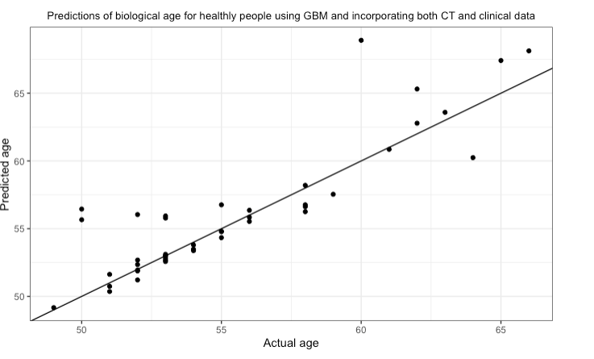
Predicting Biological Age of healthy people using GBM with CT and Clinical Data

Slide 15
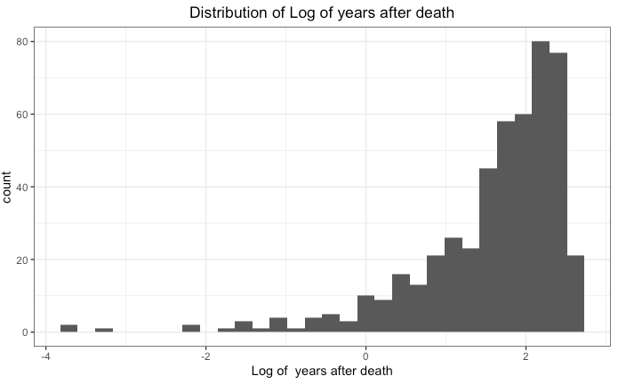
Pre-processing steps
Performed data transformation on number of days before death
Converted it to log of years
Reduced variance
Made the distribution non-uniform and less random

Slide 16
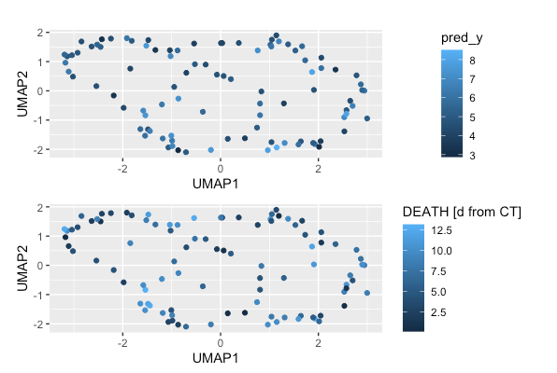
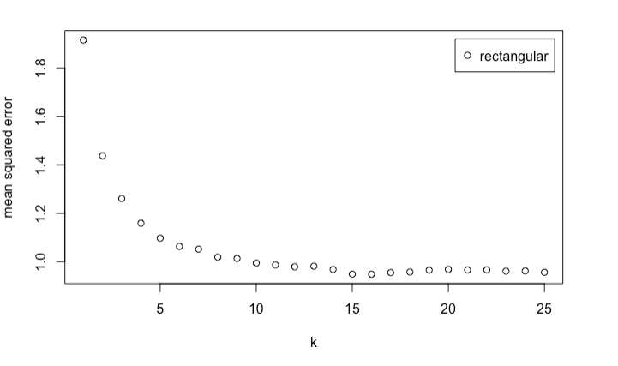
Predicting number of days before death using Weighted K-NN (only CT data)

Slide 17
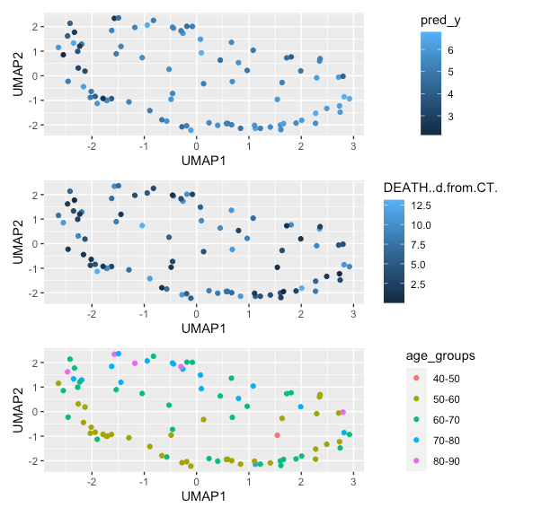
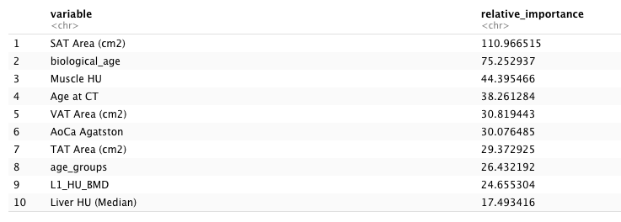
Predicting number of days before death using GBM (only CT data)

Slide 18
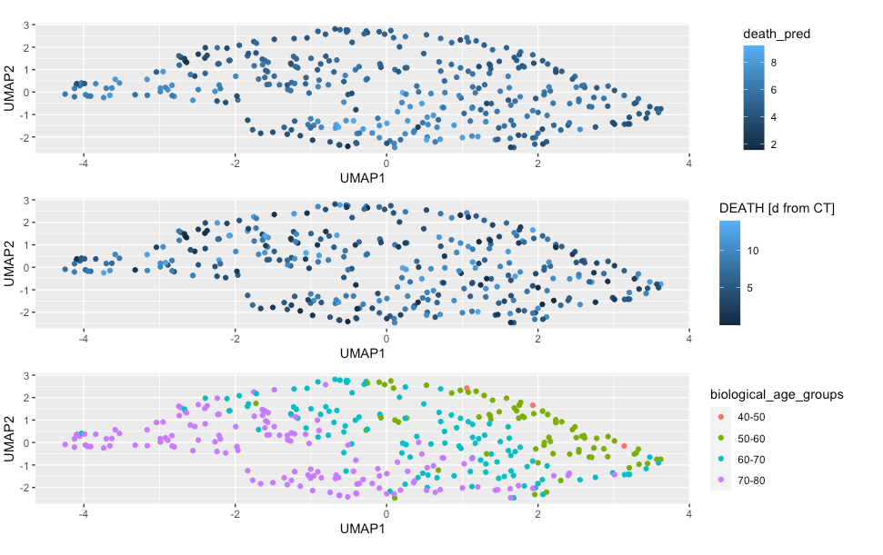
Predicting Death using Weighted K-NN with CT and Clinical Data

Slide 19
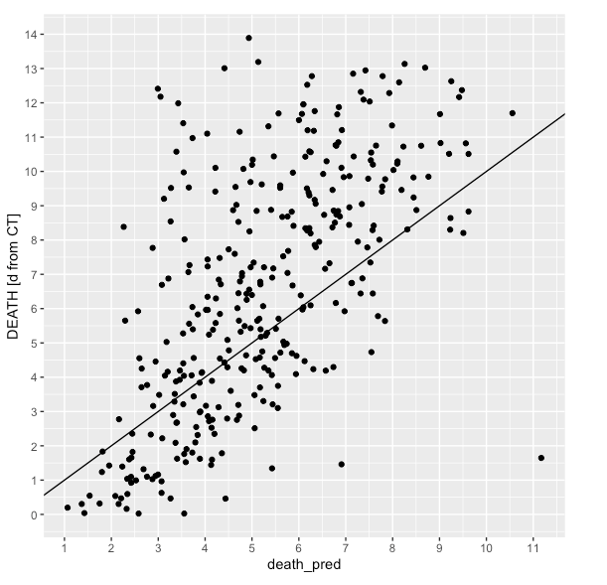
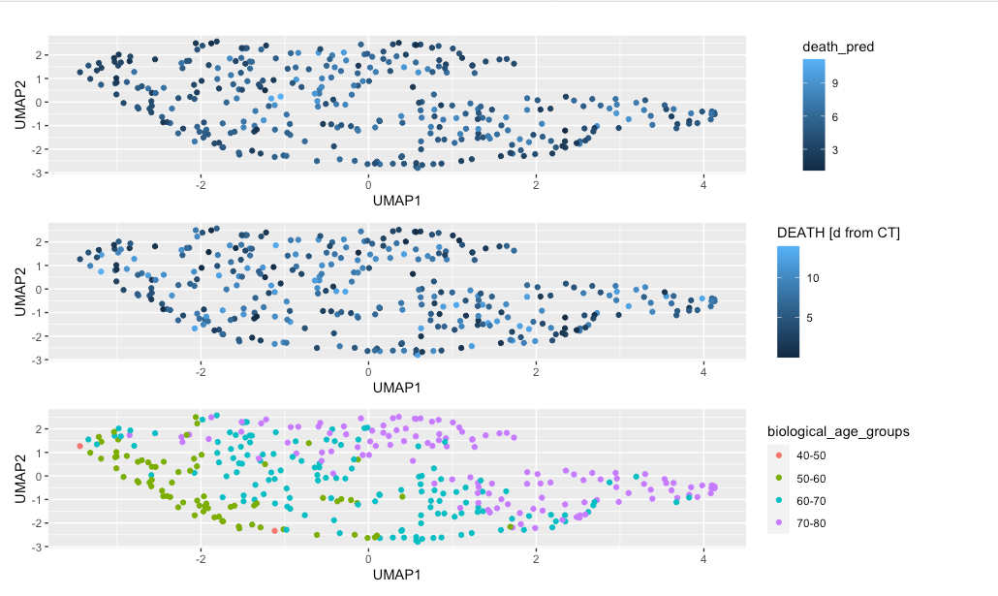
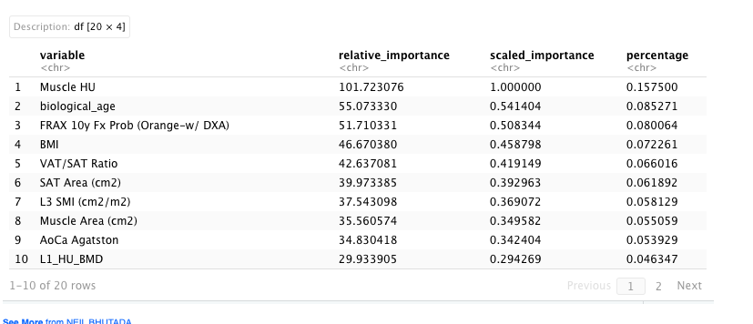
Predicting Death using GBM with CT and Clinical Data

Slide 20
Conclusion & Future Work
GBM performed better than Weighted KNN
Incorporating Clinical data improved the accuracy of prediction by at least 16%
Use stacked ensemble models
Analyze importance of tobacco, etc. by hypothesis testing

